Slide 1
Analysis of Algorithms CS 477/677
Instructor: Monica Nicolescu
Lecture 2

Slide 2
Algorithm Analysis
The amount of resources used by the algorithm
Space
Computational time
Running time:
The number of primitive operations (steps) executed before termination
Order of growth
The leading term of a formula
Expresses the behavior of a function toward infinity

Slide 3
Asymptotic Notations
A way to describe behavior of functions in the limit
How we indicate running times of algorithms
Describe the running time of an algorithm as n grows to ∞
O notation: asymptotic “less than”: f(n) “≤” g(n)
Ω notation: asymptotic “greater than”: f(n) “≥” g(n)
Θ notation: asymptotic “equality”: f(n) “=” g(n)

Slide 4
Logarithms
In algorithm analysis we often use the notation “log n” without specifying the base
Binary logarithm
Natural logarithm

Slide 5
Asymptotic Notations - Examples
For each of the following pairs of functions, either f(n) is O(g(n)), f(n) is Ω(g(n)), or f(n) is Θ(g(n)). Determine which relationship is correct.
f(n) = log n²; g(n) = log n + 5
f(n) = n; g(n) = log n²
f(n) = log log n; g(n) = log n
f(n) = n; g(n) = log² n
f(n) = n log n + n; g(n) = log n
f(n) = 10; g(n) = log 10
f(n) = 2^{n}; g(n) = 10n²
f(n) = 2^{n}; g(n) = 3^{n}
f(n) = Θ (g(n))
f(n) = Ω(g(n))
f(n) = O(g(n))
f(n) = Ω(g(n))
f(n) = Ω(g(n))
f(n) = Θ(g(n))
f(n) = Ω(g(n))
f(n) = O(g(n))

Slide 6
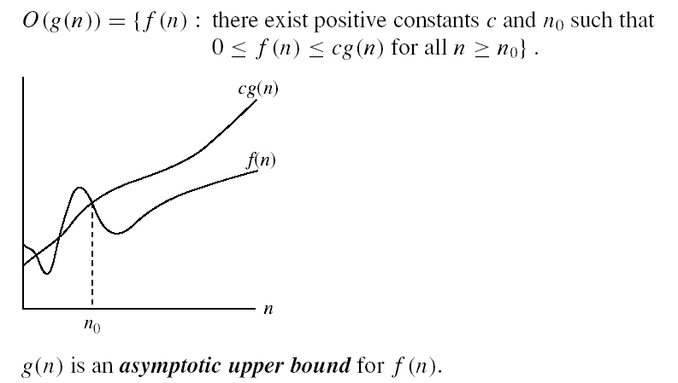
Asymptotic notations
O-notation
Intuitively: O(g(n)) = the set of functions with a smaller or same order of growth as g(n)

Slide 7
Examples
2n² = O(n³):
n² = O(n²):
1000n²+1000n = O(n²):
n = O(n²):
2n² ≤ cn³ ⇒ 2 ≤ cn ⇒ c = 1 and n₀= 2
n² ≤ cn² ⇒ c ≥ 1 ⇒ c = 1 and n₀= 1
1000n²+1000n ≤ 1000n²+ 1000n² = 2000n²
⇒ c=2000 and n₀ = 1
n ≤ cn² ⇒ cn ≥ 1 ⇒ c = 1 and n₀= 1

Slide 8
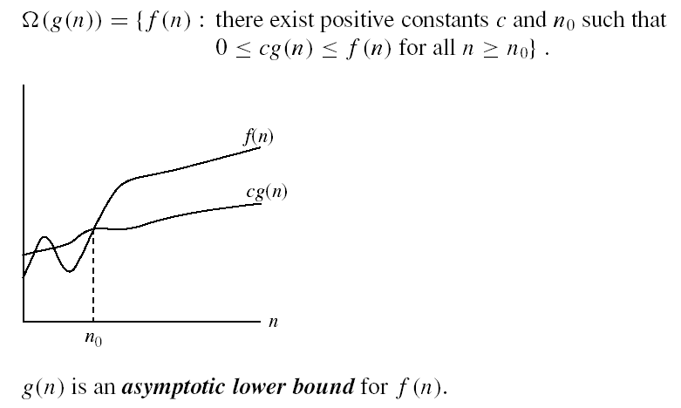
Asymptotic notations (cont.)
Ω - notation
Intuitively: Ω(g(n)) = the set of functions with a larger or same order of growth as g(n)

Slide 9
Examples
5n² = Ω(n)
100n + 5 ≠ Ω(n²)
n = Ω(2n), n³ = Ω(n²), n = Ω(logn)
∃ c, n₀ such that: 0 ≤ cn ≤ 5n²
⇒ cn ≤ 5n²
⇒ c = 1 and n₀ = 1
∃ c, n₀ such that: 0 ≤ cn² ≤ 100n + 5
100n + 5 ≤ 100n + 5n (∀ n ≥ 1) = 105n
cn² ≤ 105n
⇒ n(cn – 105) ≤ 0
Since n is positive ⇒ cn – 105 ≤ 0
⇒ n ≤ 105/c
⇒ contradiction: n cannot be smaller than a constant

Slide 10

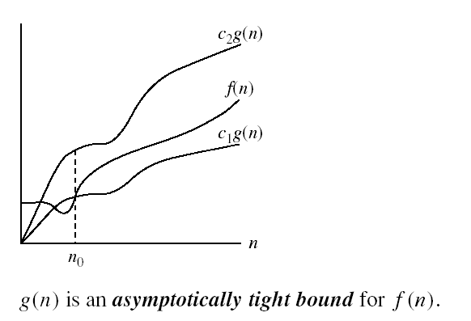
Asymptotic notations (cont.)
Θ-notation
Intuitively Θ(g(n)) = the set of functions with the same order of growth as g(n)

Slide 11
Examples
n²/2 –n/2 = Θ(n²)
½ n² - ½ n ≤ ½ n² ∀n ≥ 0 ⇒ c₂= ½
½ n² - ½ n ≥ ½ n² - ½ n * ½ n ( ∀n ≥ 2 ) = ¼ n² ⇒ c₁= ¼
n ≠ Θ(n²): c₁ n² ≤ n ≤ c₂ n²
⇒ only holds for: n ≤ 1/c₁

Slide 12
Examples
6n³ ≠ Θ(n²): c₁ n² ≤ 6n³ ≤ c₂ n²
⇒ only holds for: n ≤ c₂ /6
n ≠ Θ(logn): c₁ logn ≤ n ≤ c₂ logn
⇒ c₂ ≥ n/logn, ∀ n≥ n₀ – impossible

Slide 13
More on Asymptotic Notations
There is no unique set of values for n₀ and c in proving the asymptotic bounds
Prove that 100n + 5 = O(n²)
100n + 5 ≤ 100n + n = 101n ≤ 101n²
for all n ≥ 5
n₀ = 5 and c = 101 is a solution
100n + 5 ≤ 100n + 5n = 105n ≤ 105n² for all n ≥ 1
n₀ = 1 and c = 105 is also a solution
Must find SOME constants c and n₀ that satisfy the asymptotic notation relation

Slide 14
Comparisons of Functions
Theorem:
f(n) = Θ(g(n)) ⇔ f = O(g(n)) and f = Ω(g(n))
Transitivity:
f(n) = Θ(g(n)) and g(n) = Θ(h(n)) ⇒ f(n) = Θ(h(n))
Same for O and Ω
Reflexivity:
f(n) = Θ(f(n))
Same for O and Ω
Symmetry:
f(n) = Θ(g(n)) if and only if g(n) = Θ(f(n))
Transpose symmetry:
f(n) = O(g(n)) if and only if g(n) = Ω(f(n))

Slide 15
Asymptotic Notations in Equations
On the right-hand side
Θ(n²) stands for some anonymous function in Θ(n²)
2n² + 3n + 1 = 2n² + Θ(n) means:
There exists a function f(n) ∈ Θ(n) such that
2n² + 3n + 1 = 2n² + f(n)
On the left-hand side
2n² + Θ(n) = Θ(n²)
No matter how the anonymous function is chosen on the left-hand side, there is a way to choose the anonymous function on the right-hand side to make the equation valid.

Slide 16
Some Simple Summation Formulas
Arithmetic series:
Geometric series:
Special case: x < 1:
Harmonic series:
Other important formulas:

Slide 17
Mathematical Induction
Used to prove a sequence of statements (S(1), S(2), … S(n)) indexed by positive integers
Proof:
Basis step: prove that the statement is true for n = 1
Inductive step: assume that S(n) is true and prove that S(n+1) is true for all n ≥ 1
Find case n “within” case n+1

Slide 18
Example
Prove that: 2n + 1 ≤ 2^{n} for all n ≥ 3
Basis step:
n = 3: 2 ∗ 3 + 1 ≤ 2³ ⇔ 7 ≤ 8 TRUE
Inductive step:
Assume inequality is true for n, and prove it for (n+1)
Assume: 2n + 1 ≤ 2^{n}
Must prove: 2(n + 1) + 1 ≤ 2^{n+1}
2(n + 1) + 1 = (2n + 1 ) + 2 ≤ 2^{n} + 2 ≤
≤ 2^{n} + 2^{n} = 2^{n+1}, since 2 ≤ 2^{n} for n ≥ 1

Slide 19
Readings
Chapter 3
Apendix A

